Slide 1
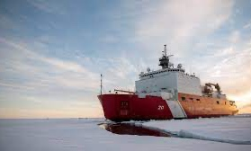
ADAC Year 8 Customer and Partner Roundtable
ADAC Project Briefing
Arctic Ice Condition Index
Jifeng Peng, University of Alaska Anchorage
Shawn Butler, University of Alaska Anchorage
Jinlun Zhang, University of Washington
Kelsey Frazier, University of Alaska Anchorage

Slide 2
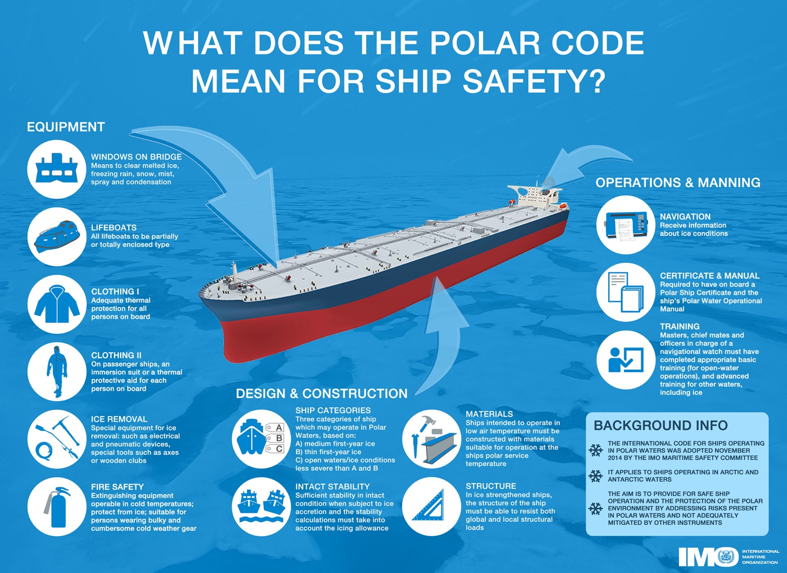
Arctic Ice Conditions Index (ARCTICE)
Description and Baseline
Leveraging team and research skills which developed Great Lakes ICECON, project ARCTICE will develop a high-resolution ice condition index for U.S. Arctic Maritime Exclusive Economic Zone (EEZ), including Bering, Chukchi and Beaufort Sea regions
ARCTICE produces an easy-to-understand numeral to communicate ice conditions that are relevant to the capabilities of an individual vessel. This index will be available for current and future ice conditions, providing forecasts up to 1 month in advance
ARCTICE supports vessel captains and officers in route planning and determining associated risk for traveling through a region of Arctic water

Slide 3
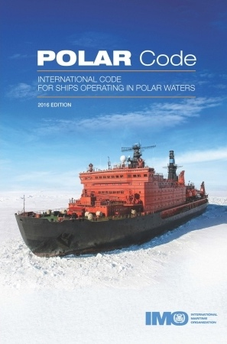
Arctic Ice Conditions Index (ARCTICE)
Description and Baseline
Historically many Arctic nations use their own methods for communicating ice conditions. Following the addition of the “POLARIS amendment” to the International Maritime Organization (IMO) Polar Code, communication tools on ice conditions started to migrate to a uniform methodology.
The POLARIS amendment to the IMO Polar Code is based on vetted ice condition processes from the Canadian AIRSS system, the Russian Ice Certificate concept, and additional inputs from other coastal administrators.
While the IMO has no existing or planned international enforcement privileges, the IMO Polar Code is seen as a “best practices” guide, many nations require that vessels comply with the Polar Code.

Slide 4
Arctic Ice Conditions Index (ARCTICE)
Relevance to DHS and USCG
  Exponential increases in ship traffic through US Arctic EEZ
  Foreign industry is transporting LNG through Chukchi and Bering Sea year round, attracting interest from other companies and nations
  Arctic mariners experience long distances between ports of call, communication shortfalls, increasingly unpredictable weather patters, and limited USCG SAR availability
  Vessels historically have travelled through the ice without knowledge of potential risks from the sea ice, sometimes getting stuck and needing assistance

Slide 5
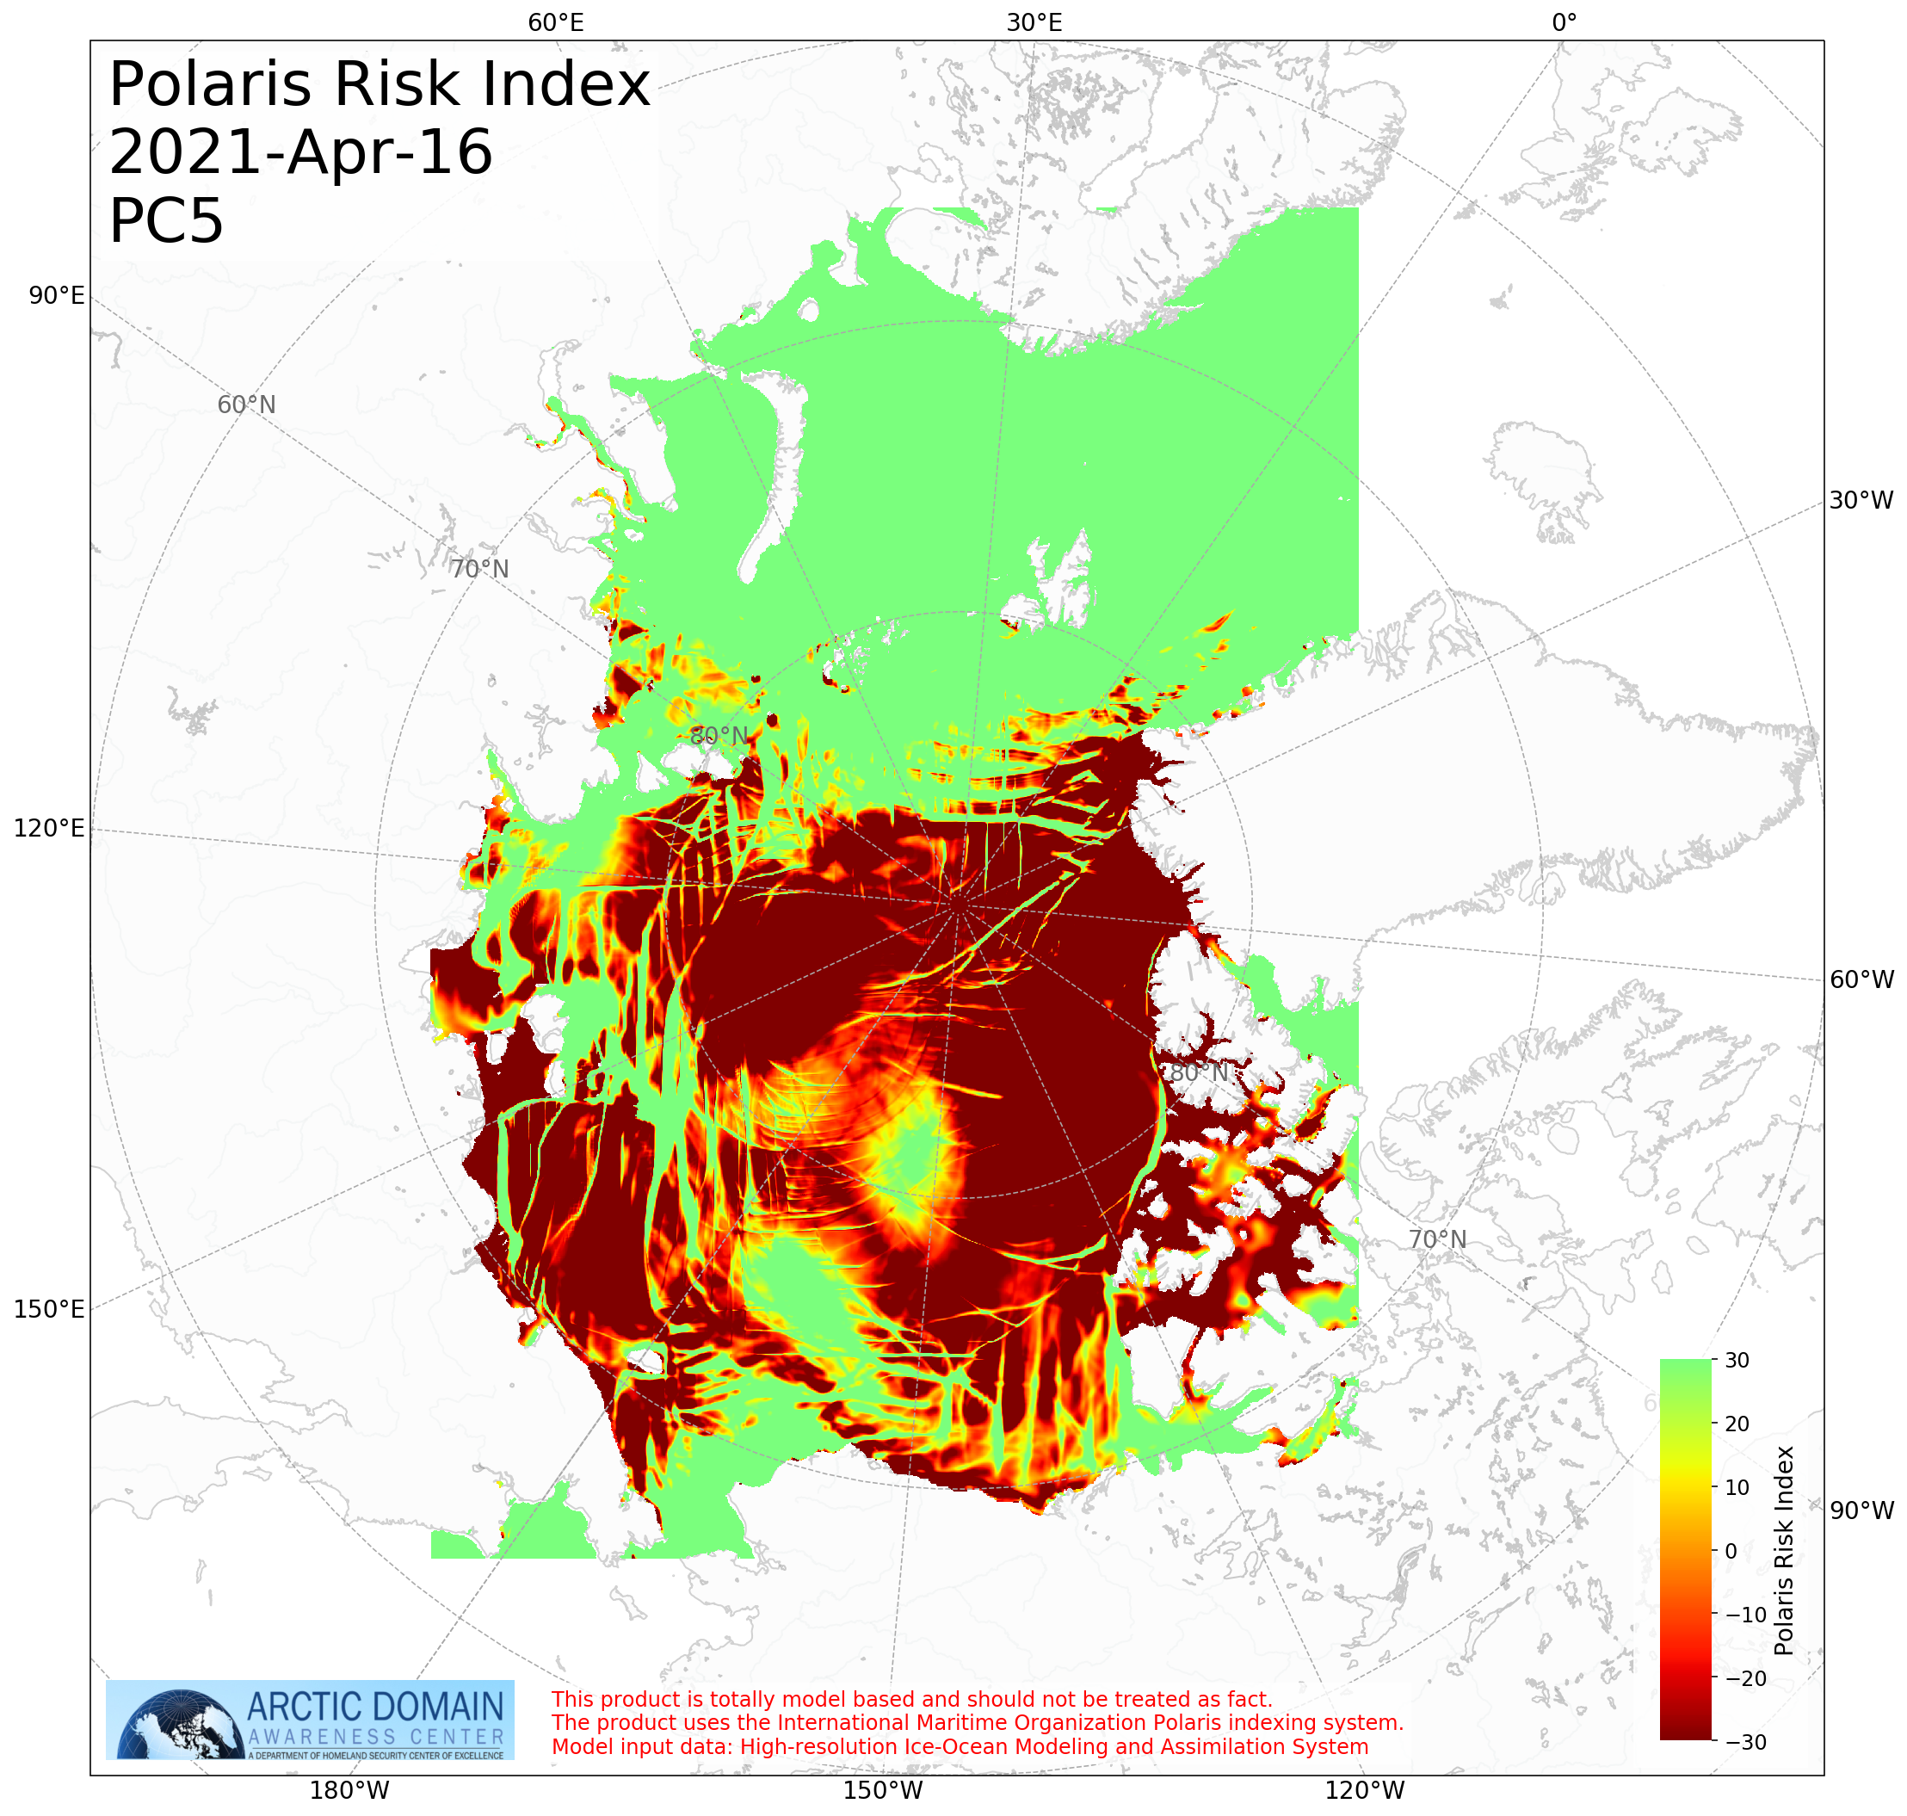
Arctic Ice Conditions Index (ARCTICE)
Prior Work Completed
Provide and confirm the ARCTICE vessel classification index;
Investigate other national models (in particular, Canadian programs)
Determine suitable environmental factors;
Integration of the index to a visualization tool as an aid to vessel mariner planning and underway activities;
Transition the ARCTICE to an operational destination.

Slide 6
Arctic Ice Conditions Index (ARCTICE)
Project year 8 workplan
Conduct ARCTICE validation;
Increase the accessibility of ARCTICE products;
Transition the ARCTICE to an operational destination;
Investigate application of ARCTICE RIO charts to forecast Bering Strait traffic bound for a future Arctic Port in Nome, AK.

Slide 7
Arctic Ice Conditions Index (ARCTICE)
Project year 8 workplan
Conduct ARCTICE validation;
  Received part of the ice data from USNIC on board Healy (acknowledgement to Sofia Montalvo, Michael Lowe and Bailey Miller from USNIC);
  Data analysis in Q2.

Slide 8
Arctic Ice Conditions Index (ARCTICE)
Project year 8 workplan
Conduct ARCTICE validation;
Increase the accessibility of ARCTICE products;
  Collaborated with Axiom Data Science on making the website more user-friendly.
  New website: https://arctice.srv.axds.co/

Slide 9
Arctic Ice Conditions Index (ARCTICE)
Project year 8 workplan
Conduct ARCTICE validation;
Increase the accessibility of ARCTICE products;
Transition the ARCTICE to an operational destination;
  Teleconference with project champions on Aug 20;
  Teleconference with Axiom data science on Sep 16.

Slide 10
Arctic Ice Conditions Index (ARCTICE)
Project year 8 workplan
Conduct ARCTICE validation;
Increase the accessibility of ARCTICE products;
Transition the ARCTICE to an operational destination;
Investigate application of ARCTICE RIO charts to forecast Bering Strait traffic bound for a future Arctic Port in Nome, AK (Q3).

Slide 11
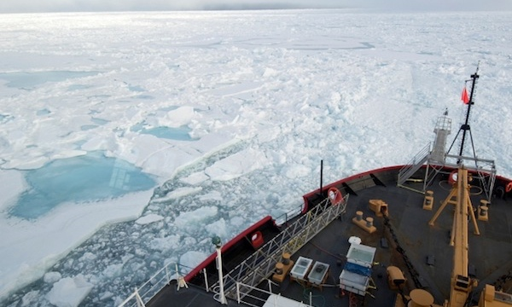
Ready for Questions
Feedback…
What are we missing?
What can we improve?
Who should we connect with to improve odds of research success?
Notes:
Thank you for the gift of your time and attention.

